Slide 1
Finding High-Quality Content in Social Media
Eugene Agichtein, Carlos Castillo, Debora Donato,
Aristides Gionis and Gilad Mishne (WSDM 2008)
Advisor：Dr. Koh Jia-Ling
Speaker：Tu Yi-Lang
Date：2009.03.09

Slide 2
Outline
Introduction
Content Quality Analysis In Social Media
Modeling Content Quality In Community Question/Answering
Experimental Setting
Experimental Results
Conclusion

Slide 3
Introduction
From the early 2000s, user-generated content has become increasingly popular on the web, more and more users participate in content creation, rather than just consumption.
Popular user generated content (or social media) domains include blogs and web forums, social bookmarking sites, photo and video sharing communities.

Slide 4
Introduction
The main challenge posed by content in social media sites is the fact that the distribution of quality has high variance.
As the availability of such content increases, the task of identifying high-quality content in sites based on user contributions—social media sites— becomes increasingly important.

Slide 5
Introduction
The question/answering portals, in which users answer questions posed by other users, provide an alternative channel for obtaining information on the web.
Not just browsing results of search engines, users present detailed information needs and get direct responses authored by humans.
A user can vote for answers of other users, mark interesting questions, and even report abusive behavior.

Slide 6
Content Quality Analysis In Social Media
Evaluation of content quality is an essential module for performing more advanced information retrieval tasks on the question/answering system.
Exploiting features of social media that are intuitively correlated with quality, and then train a classifier to appropriately select and weight the features for each specific type of item, task, and quality definition.
  Intrinsic content quality
  User relationships
  Usage statistics

Slide 7



Content Quality Analysis In Social Media
Intrinsic content quality
  The intrinsic quality metrics focus on the text.
  As a baseline, here using textual features only：with all word n-grams up to length 5 that appear in the collection more than 3 times used as features.
  Punctuation and typos：capitalization rules may be ignored; excessive punctuation, or spacing may be irregular.
  A particular form of low visual quality is misspellings and typos; additional features in the set quantify the number of out-of-vocabulary words and spelling mistakes.

Slide 8
Content Quality Analysis In Social Media
Intrinsic content quality (cont.)
  Syntactic and Semantic Complexity：these include simple proxies for complexity such as the average number of syllables per word or the entropy of word lengths.
  Grammaticality：using several linguistically-oriented features, like part-of-speech (POS) tags.
    “when | how | why to (verb)” (as in “how to identify. . . ”) →lower quality questions
    “when | how | why (verb) (personal pronoun) (verb)” (as in “how do I remove. . . ”)

Slide 9
Content Quality Analysis In Social Media
User relationships
  A significant amount of quality information can be inferred from the relationships between users and items.
  For example, it could apply to QA system, the main challenge is that the dataset, viewed as a graph：
    nodes of multiple types.
    (e.g., questions, answers, users)
    edges represent a set of interaction among the nodes having different semantics.
    (e.g., “answers”, “gives best answer”, “votes for”, “gives a star to”)

Slide 10
Content Quality Analysis In Social Media
User relationships (cont.)
  The resulting user-user graph is extremely rich and heterogeneous, and is unlike traditional graphs studied in the web link analysis setting.
  However, still believing that traditional link analysis algorithm may provide useful evidence for quality classification, tuned for the particular domain.
  Hence, for each type of link it performed a separate computation of each link-analysis algorithm, including hubs and authorities scores, the PageRank scores.

Slide 11
Content Quality Analysis In Social Media
Usage statistics
  Usage statistics such as the number of clicks on the item and dwell time have been shown useful in the context of identifying high quality web search results, and are complementary to link-analysis based methods.
  For example, all items within a popular category such as celebrity topics may receive orders of magnitude more clicks than, for instance, science topics.
  →it should be normalized by the item category

Slide 12
Content Quality Analysis In Social Media
Overall classification framework
  Here casting the problem of quality ranking as a binary classification problem, in which a system must learn automatically to separate high quality content from the rest.
  Experimented with several classification algorithms, the best performance among the techniques we tested was obtained with stochastic gradient boosted trees.

Slide 13
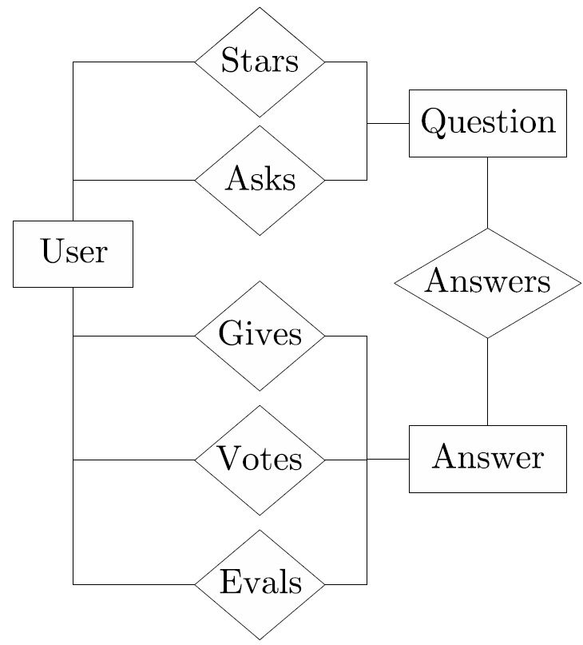
Modeling Content Quality In Community Question/Answering
Application-Specific User Relationships
  The main forms of interaction
  among the users：
    asking a question
    answering a question
    selecting best answer
    voting on an answer

Slide 14
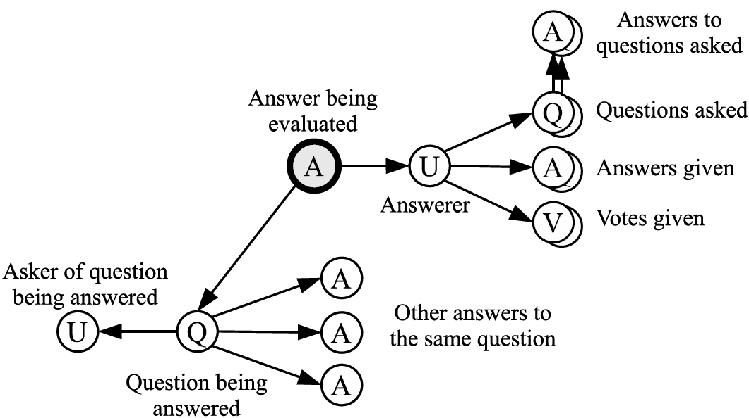
Modeling Content Quality In Community Question/Answering
Application-Specific User Relationships (cont.)
  Using multi-relational features to describe multiple classes of objects and multiple types of relationships between these objects.
  Answer features：the types of the data related to a particular answer form a tree, in which the type “Answer” is the root.

Slide 15
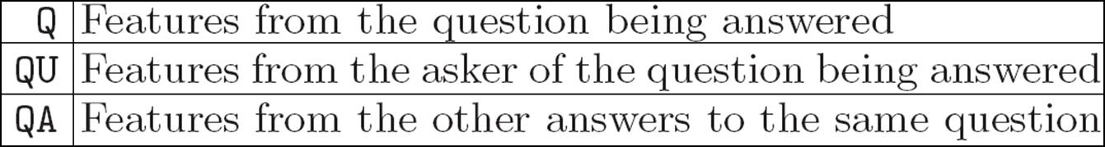
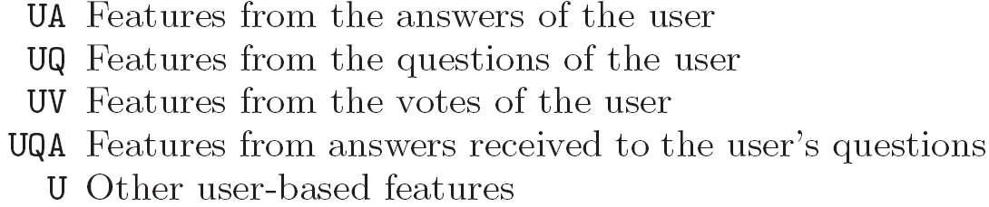
Modeling Content Quality In Community Question/Answering
  Two subtrees starting from the answer being evaluated：
    the types of features on the question subtree are：
    the types of features on the user subtree are：

Slide 16
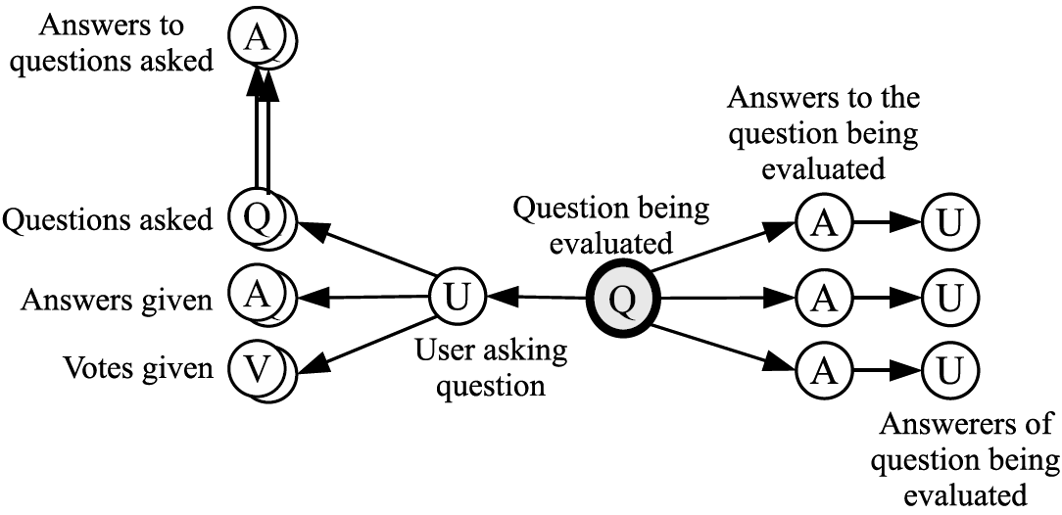
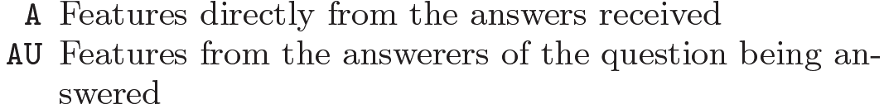
Modeling Content Quality In Community Question/Answering
Application-Specific User Relationships (cont.)
  Question features：“Question” is the root.

Slide 17
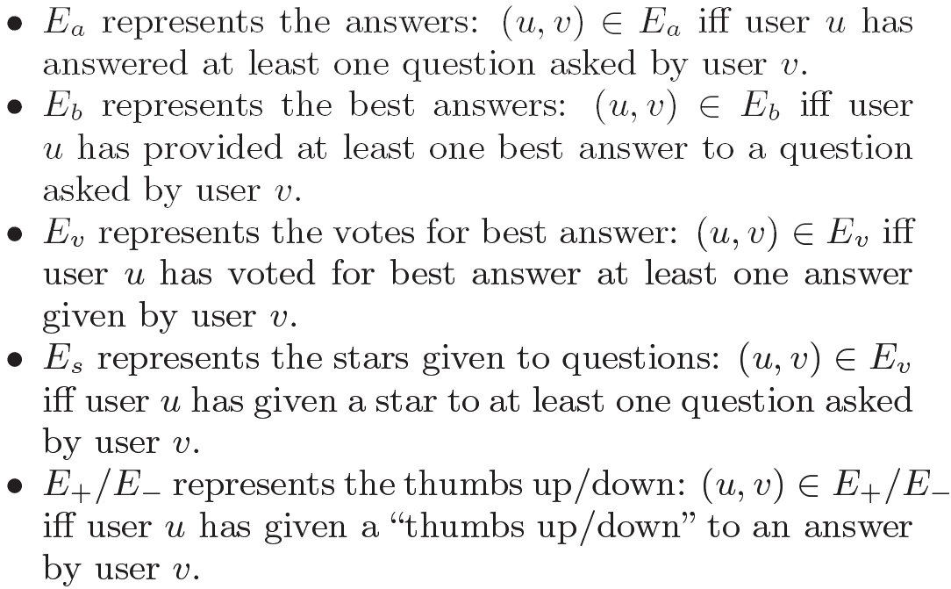
Modeling Content Quality In Community Question/Answering
Application-Specific User Relationships (cont.)
  Implicit user-user relations：

Slide 18
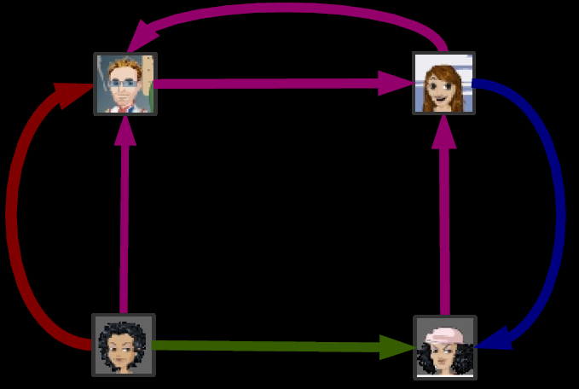
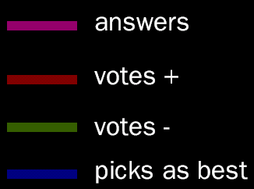
Modeling Content Quality In Community Question/Answering
Application-Specific User Relationships (cont.)
  Propagation-based metrics：
    Pagerank score
    HITS hub score
    HITS authority score
1
1
1
2
2
1
1
4
3
4
3

Slide 19
Modeling Content Quality In Community Question/Answering
Content features for QA
  Intuitively, a copy of a Wall Street Journal article about economy may have good quality, but would not (usually) be a good answer to a question about celebrity fashion.
  To represent this, include the KL-divergence between the language models of the two texts, their non-stopword overlap, the ratio between their lengths, and other similar features.

Slide 20
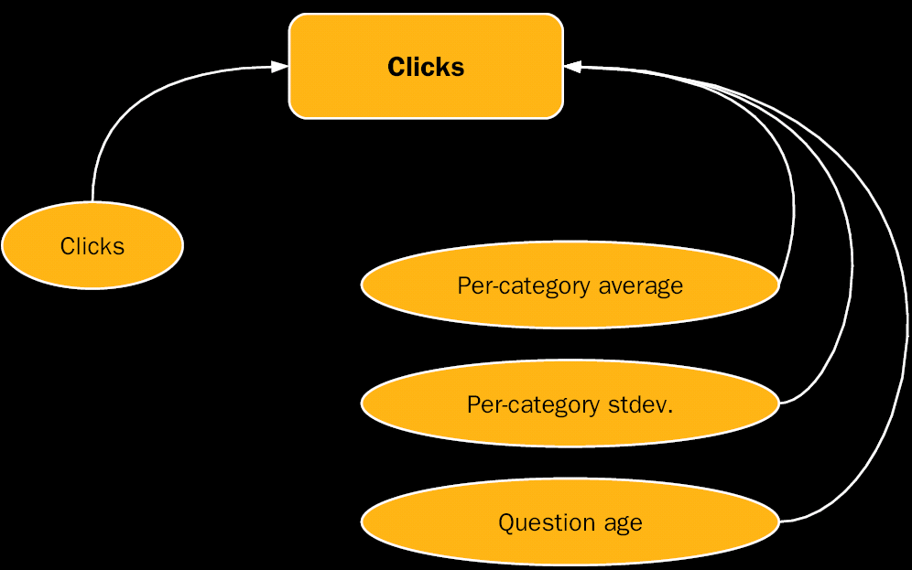
Modeling Content Quality In Community Question/Answering
Usage features for QA
  As a base set of content usage features we use the number of item views (clicks).

Slide 21
Experimental Setting
Dataset
  The dataset consists of 6,665 questions and 8,366 question-answer pairs.
  All of the above questions were labeled for quality by human editors, who were independent from the team that conducted this research.
  Editors graded questions and answers for well-formedness, readability, utility, and interestingness; for answers, an additional correctness element was taken into account.

Slide 22
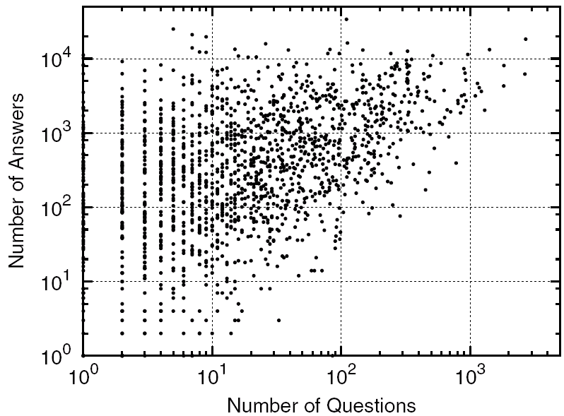
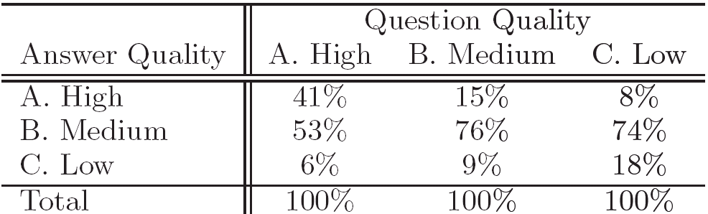
Experimental Setting
Dataset statistics
  In the sample of users, most users participate as both “askers” and “answerers”.
  In the evaluation dataset there is a positive correlation between question quality and answer quality.

Slide 23
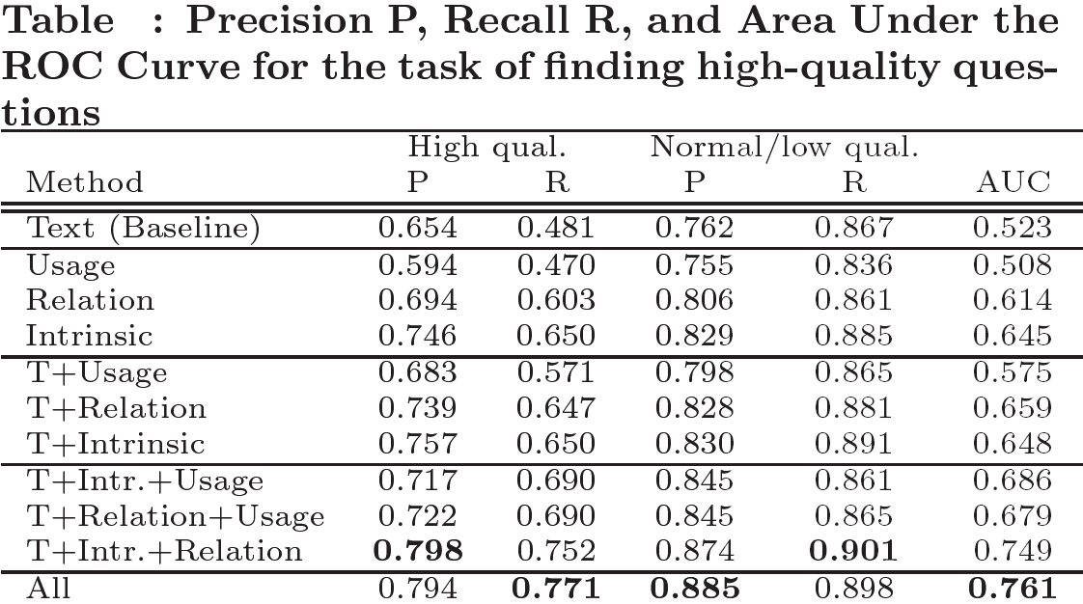
Experimental Results
Question Quality

Slide 24
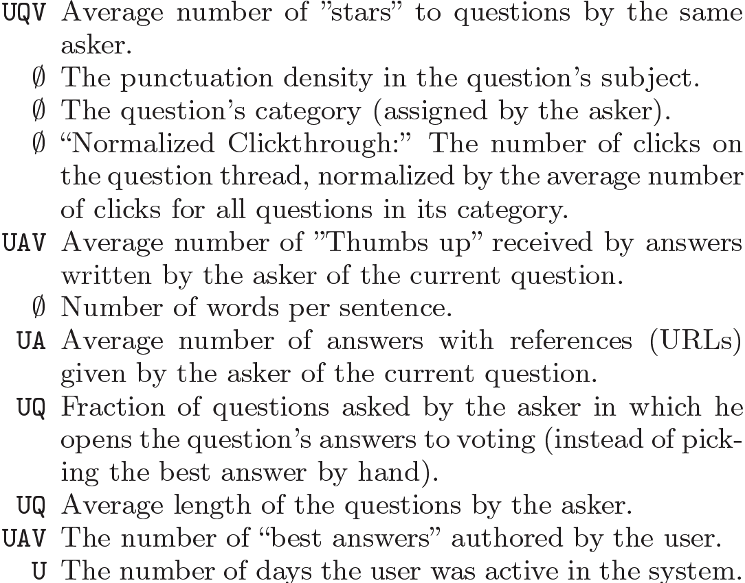
The 10 Most Significant Feature (Question)

Slide 25
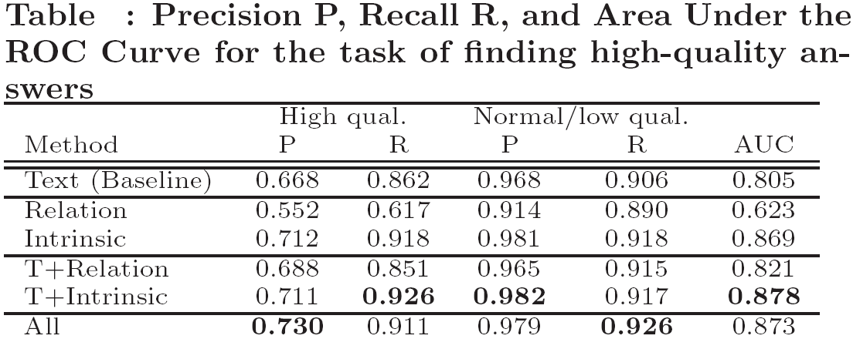
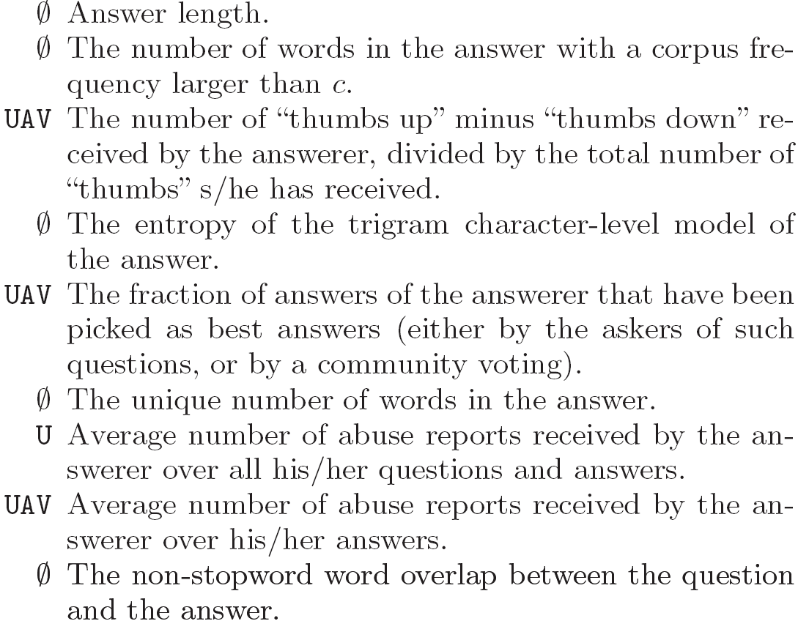
Experimental Results
Answer Quality
The 10 most significant feature

Slide 26
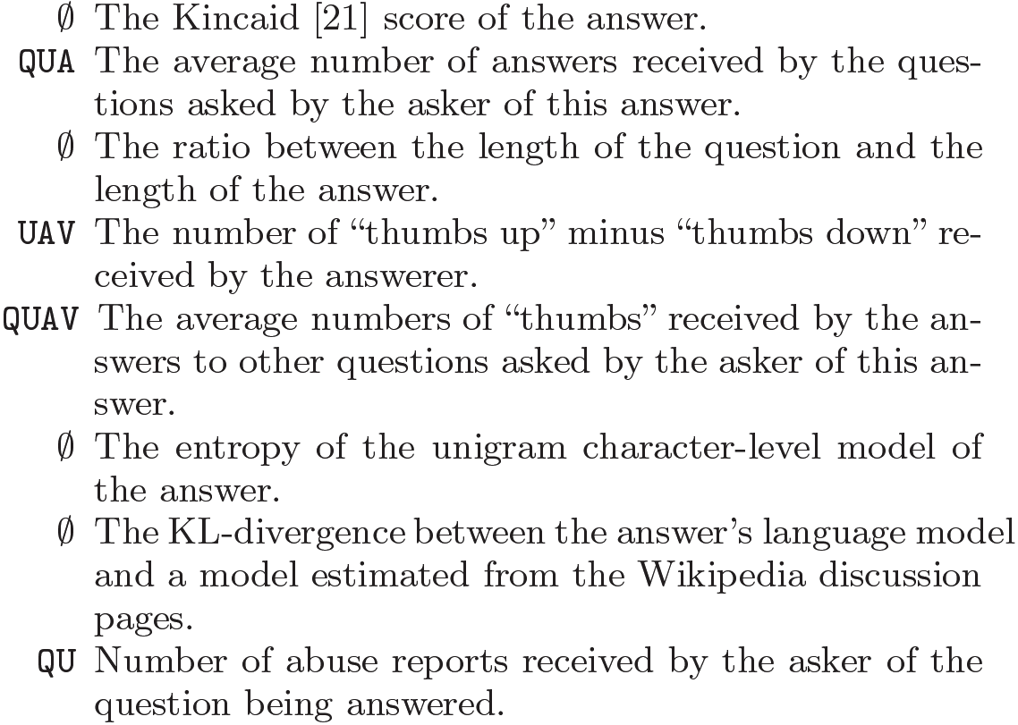
The 10 Most Significant Feature (Answer)

Slide 27
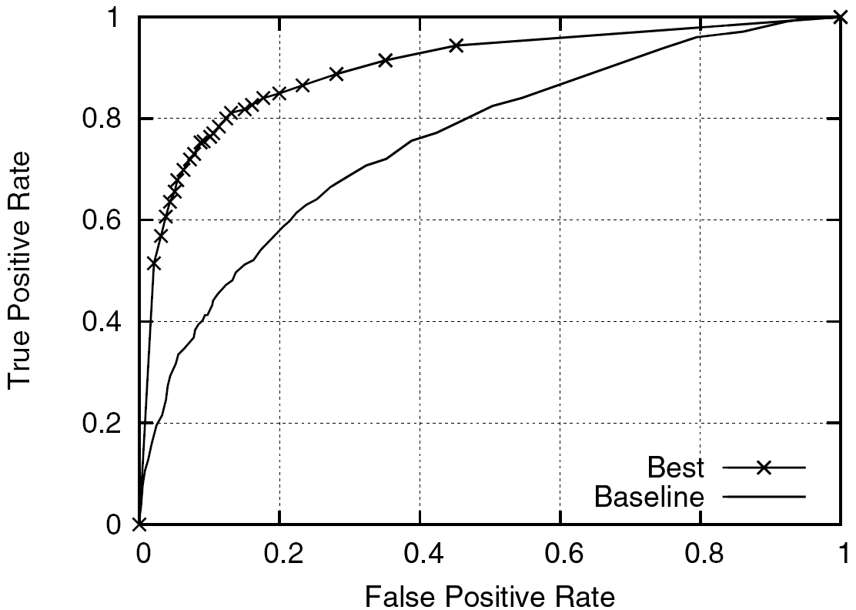
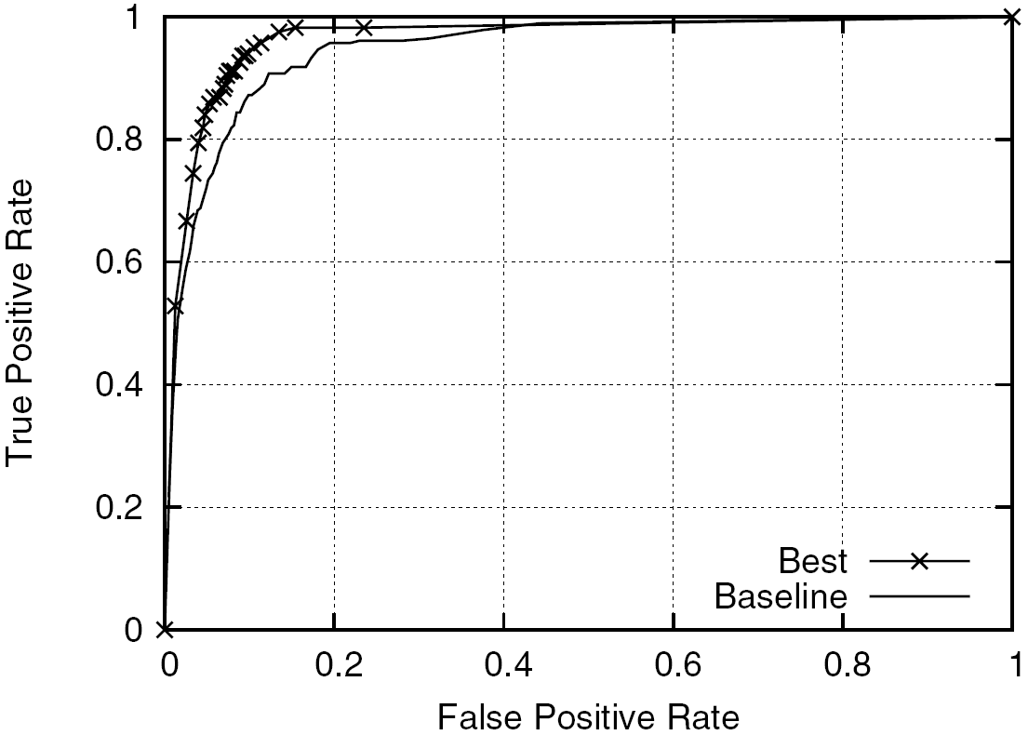
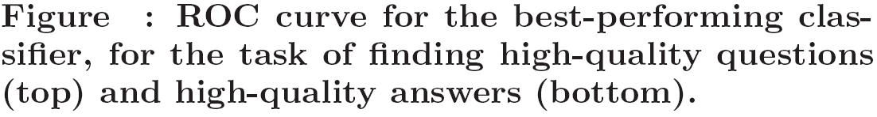
Experimental Results

Slide 28
Conclusion
In this paper, it investigates methods for exploiting such community feedback to automatically identify high quality content.
Developing a comprehensive graph-based model of contributor relationships and combined it with content- and usage-based features.

Slide 29
Conclusion
This paper introduces a general classification framework for combining the evidence from different sources of information.
For the community question/answering domain, it shows that the system is able to separate high-quality items from the rest with an accuracy close to that of humans.

